Slide 1
AlphaMicron Inc.
1950 State Route 59
Kent OH 44240
330-676-0648
www.alphamicron.com

Slide 2
E-Tint: Electronic Tint on demand
Background
Current Market
Automotive Application
Future

Slide 3
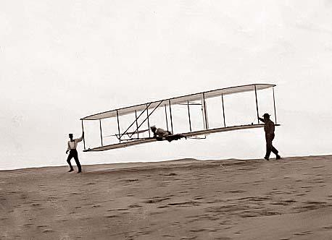
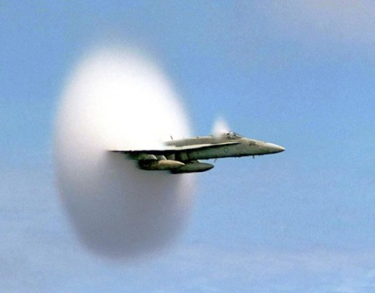
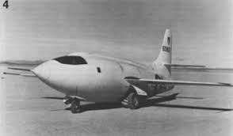
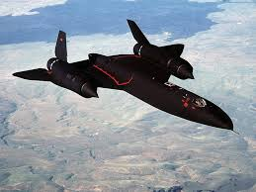


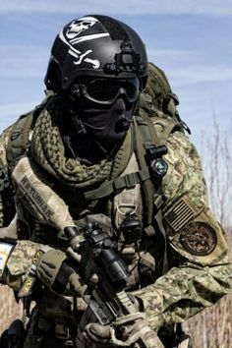
Background: Evolution of Technology
60Km/hour
1200Km/hour
8400Km/hour
1903
1947
1990
Technology evolves very fast

Slide 4
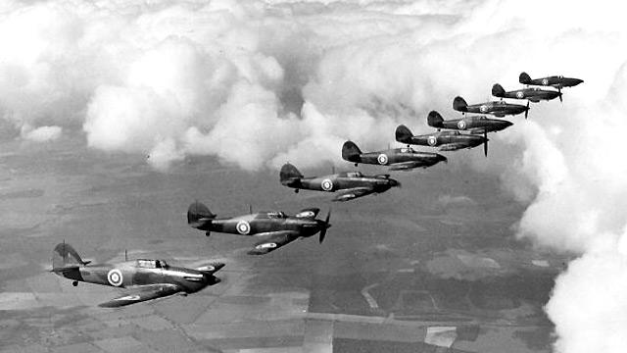
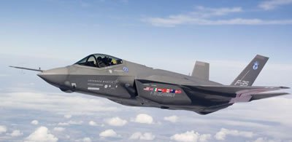
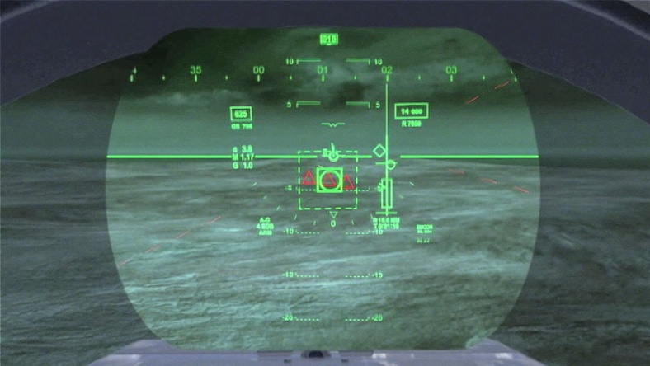


Background: Evolution of Battle Field
Rapidly changing battlefields

Slide 5
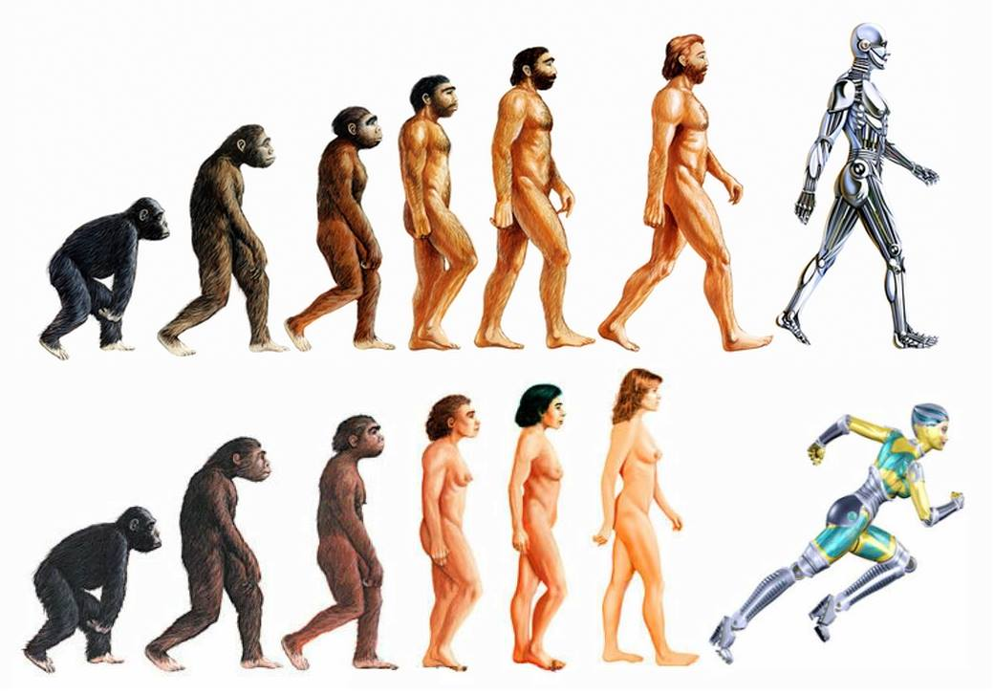
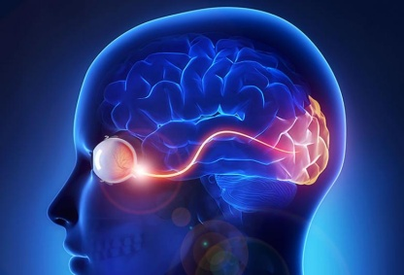
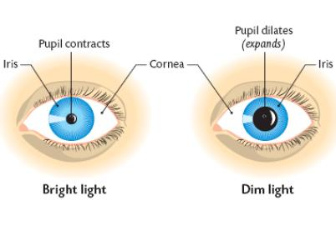


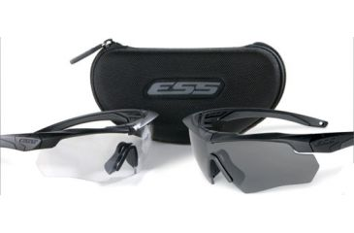
Background: Evolution of Humans
80% of all information received through eye. 4 times more than all our senses COMBINED
Little Change in 80,000 years!
Our eye response to changes in lighting conditions in several seconds to minutes

Slide 6
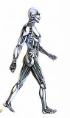

How do we address the current disparity between human response and environmental conditions?
Replace Human with fast acting computer/
Autonomous systems
Create an interface which acts as a “shock-absorbers” between human response and ambient world

Slide 7
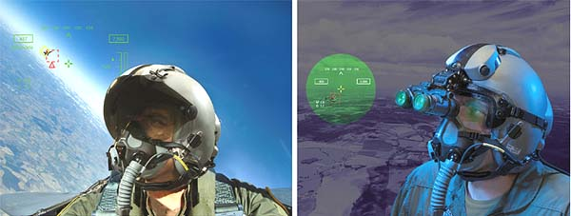
History: AlphaMicron
• Wright Patterson AFB: Largest National Lab based LC research
• Problem: Ambient light control for helmet mounted displays.
• Unsuccessful attempts by several companies/technologies
Need for a new light management technology

Slide 8
Technologies evaluated
Photochromic: UV induced change in visible transmission
Advantages: no electronics
Disadvantage: Slow, Needs UV, Short Lifetime, No Control
PDLC: Polymer Dispersed Liquid Crystals
Advantages: Polymer film
Disadvantage: Scattering, Short Lifetime, ↑ Power Consumption
SPD: Suspended Particle Dispersion
Advantages: ?
Disadvantage: Color, Short Lifetime, Scattering, ↑ Consumption
Electrochromic: Current induced oxidation/Redox
Advantages: Wide swing, vacuum coated
Disadvantage: Hazardous, Bistable, cost, slow

Slide 9
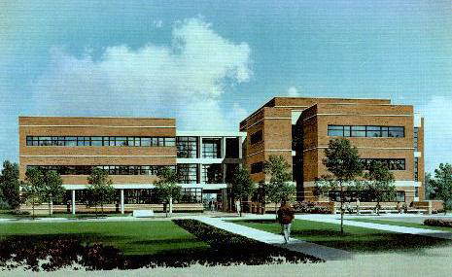
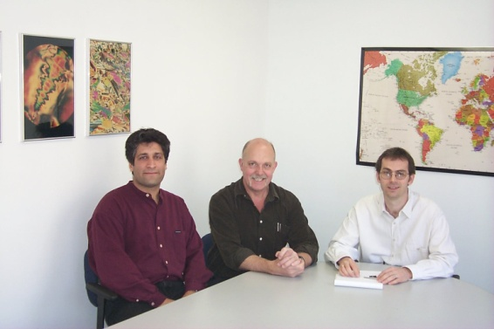
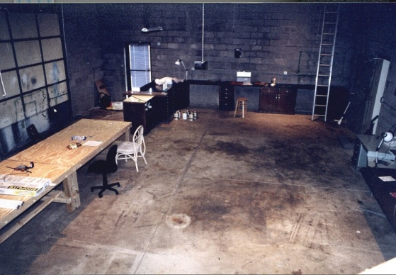
History: AlphaMicron
• Liquid Crystal Institute
Largest University based LCD Research
• Leader in liquid crystal research in the USA
• Hub for the NSF’s ALCOM center
TN invented at LCI
PDLC invented at LCI
Established 1996

Slide 10
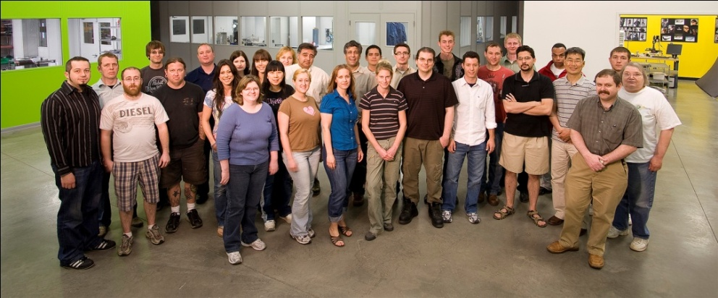
Current AlphaMicron
20 years in operation
>$50M in revenues generated in that time through sale of products/services
All money reinvested in the company
No outside investor
Cash flow positive
25 People
50% with higher education PhD, MS/MBA
30,000 sqft facility
10,000 sqft Class 1000 cleanroom

Slide 11
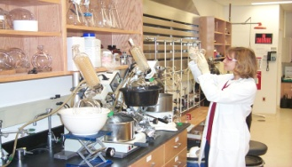
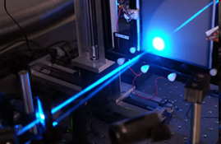
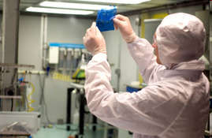
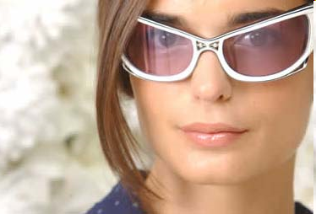
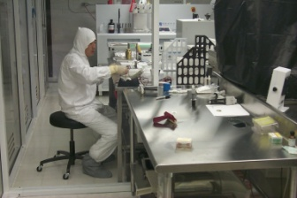
AlphaMicron
Materials
Synthesis of specialty chemical
Liquid Crystal formulation
Guest-host systems
Characterization
Laser labs
Spectroscopy labs
Environmental testing labs
Processing
Liquid crystal devices
Flexible plastic substrates
Optical films
Design
Industrial design
Electronic engineering
Consumer design
Manufacturing
Inspection shutter
e-Tint on plastic
Roll to roll functional film

Slide 12

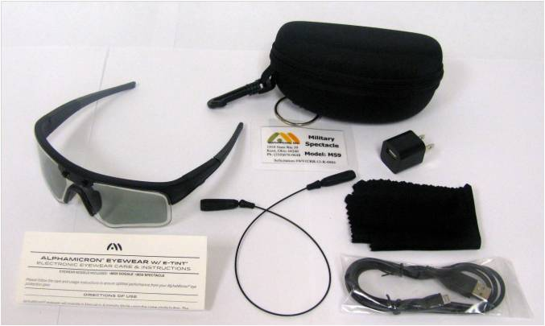
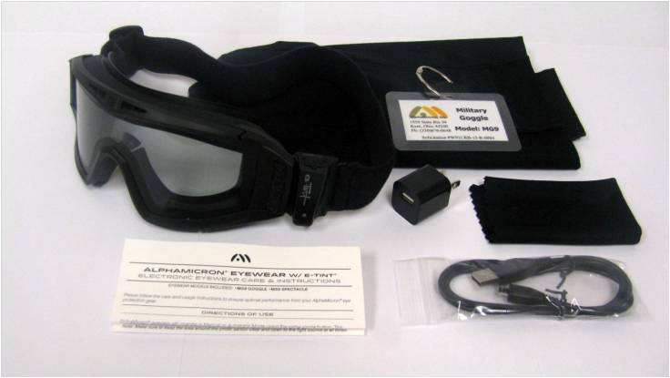
Disruptive Change to Eyewear Industry
Transition Combat Eyewear Program (TCEP)
The world’s first electronic tint-on-demand system.
Requirement is written in the new APEL Mil-Spec
E-Tint is the only technology that meets the Spec

Slide 13
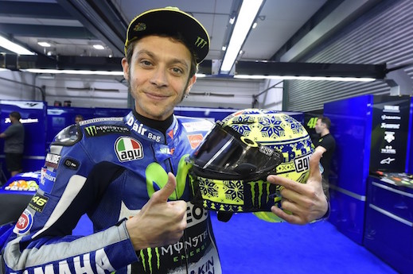
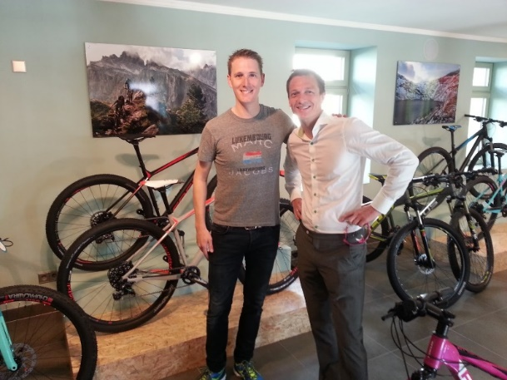
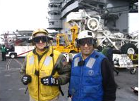
Working with Leaders
Navy Seals
Navy Sailors
Army Soldiers
Motorcyclist
Bicyclists
Runners

Slide 14
E-Tint Technology

Slide 15
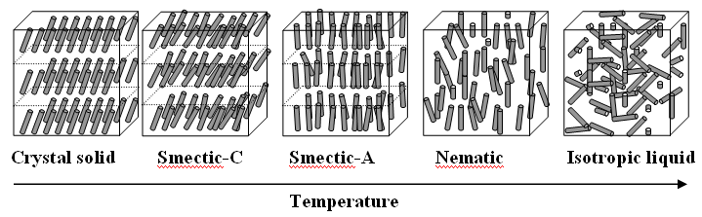
Liquid Crystals

Slide 16
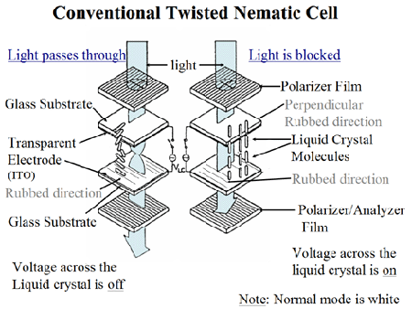
Conventional LCDs

Slide 17
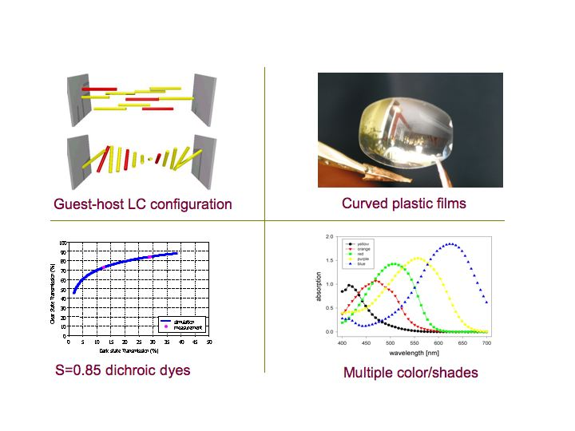
e-Tint Technology

Slide 18
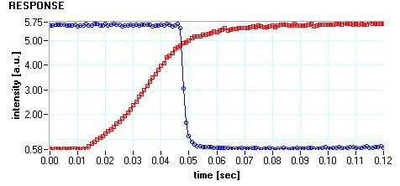
e-Tint Technology
Response time <0.1 s

Slide 19
e-Tint Technology

Slide 20
e-Tint Technology

Slide 21
Expansion to Other Industries

Slide 22
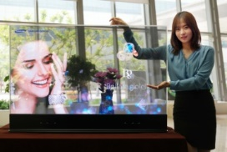
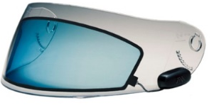

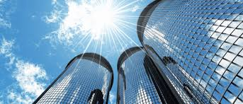
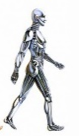


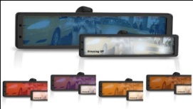

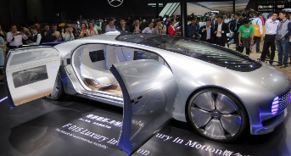
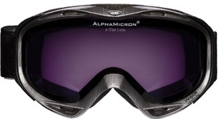
Current Overall Strategy
Market size
Penetration
Licensing
B-B
Joint Venture
B-B/C
S. Alliance
B-C/B
Own Brand
B-C

Slide 23
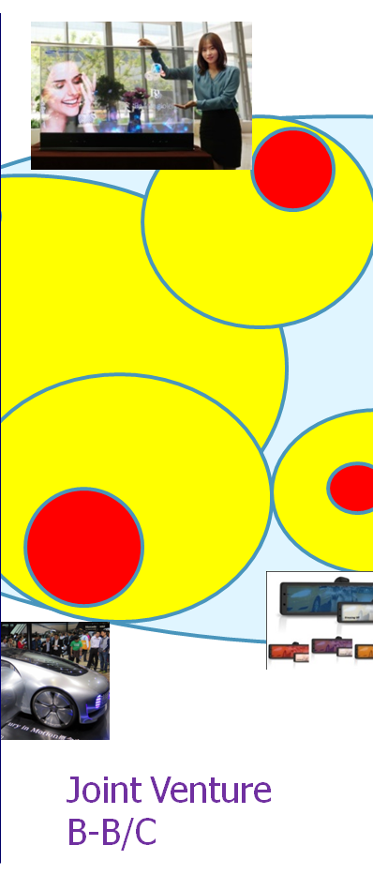

Display and automotive market
Markets:
Automotive glass
OLED displays
Head-up displays
Autodimming mirrors
Strategy:
License+JV
Help partner/setup production
Sell LC material
Develop next Gen system
Status:
Licensed DNP
Working with Pilkington
Working with Saint Gobain
Working with Inalfa

Slide 24
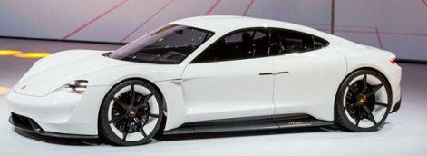
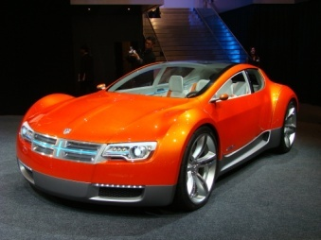
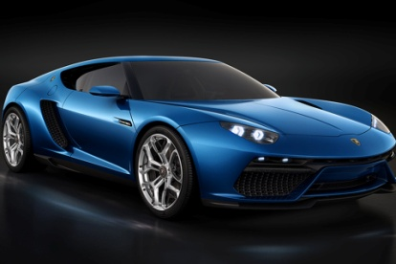
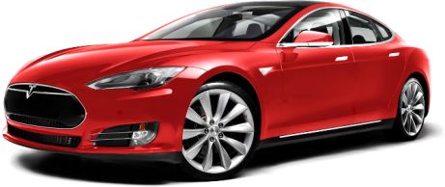
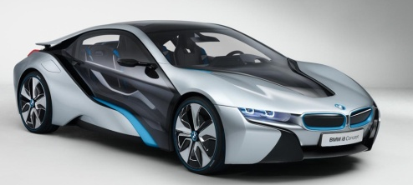
Technological Cars
High end
Cool factor important
Glass sunroofs are standard already
Battery/Hybrid
HUGE DESIRE FOR LIGHTING CONTROL

Slide 25
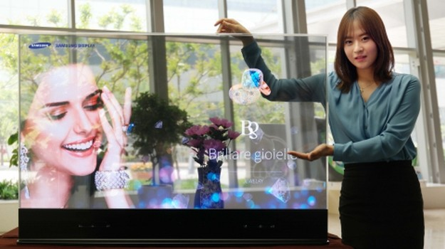
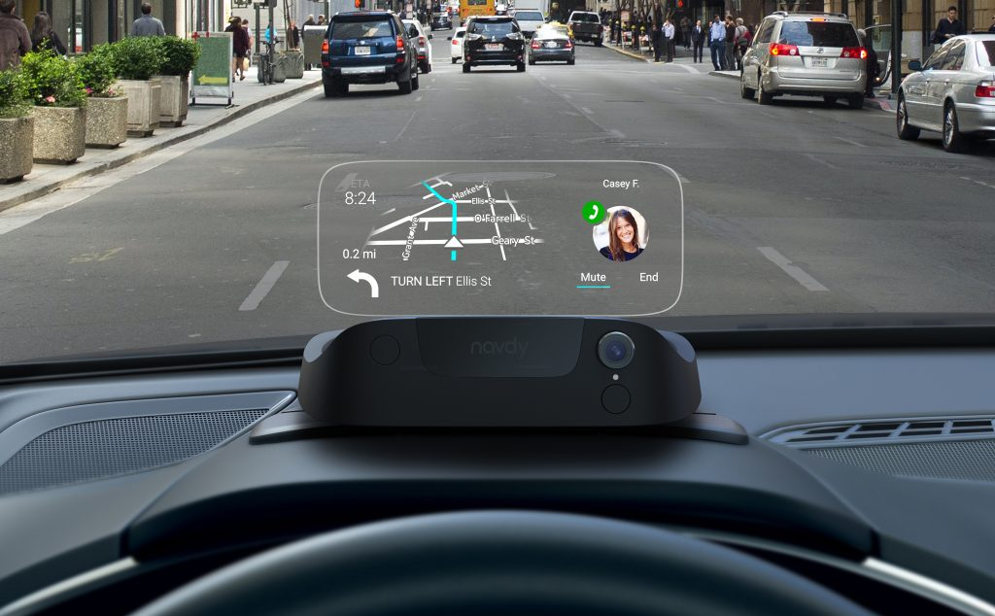
HUD / See through displays
Working with
Samsung
Visteon
Magna
DNP

Slide 26
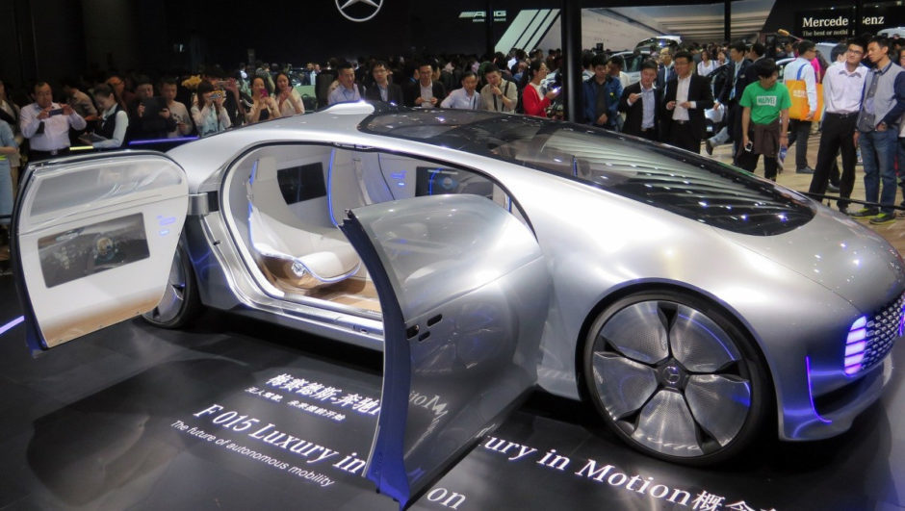
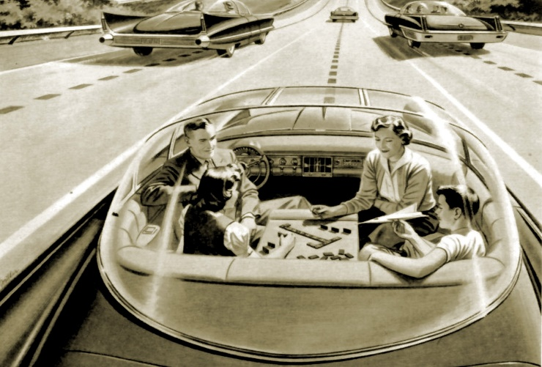
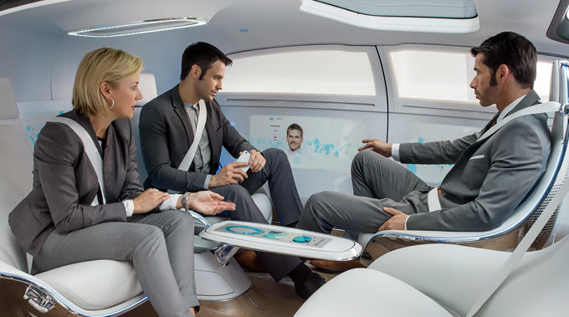
Self Driving Cars
1950s concept
Greenhouse effect: Inside temp can rise to >80ºC
Control of SHGC is essential
Mercedes concept car

Slide 27

Example: Sunroof
https://www.youtube.com/watch?v=42O_gBEgWL8
AlphaMicron working
with Inalfa/Pilkington/DNP/OEM team

Slide 28










What makes AlphaMicron unique?
Protected Technology
Production Capability
Knowhow
Patents
Trade secrets
(Material formulation)
Roll-to-Roll manufacturing
0.6 m wide line
Automated
Strategic Partners
Access to Expertise
DNP
Webasto
Inalfa
Saint Gobain
Pilkington
Asahi Glass

Slide 29

FUTURE
Voice activation
Change color of window
Change the Tint
Change Privacy setting

